Slide 1
Interim draft Requirements Breakdown 2015-11-11
Slide 3 is updated from ”old” guide
Other slides are from Community material by Göran Frank & Erika Janemyr and from
“Requirements management Intro” by DRS Assembled by Peter N

Slide 2
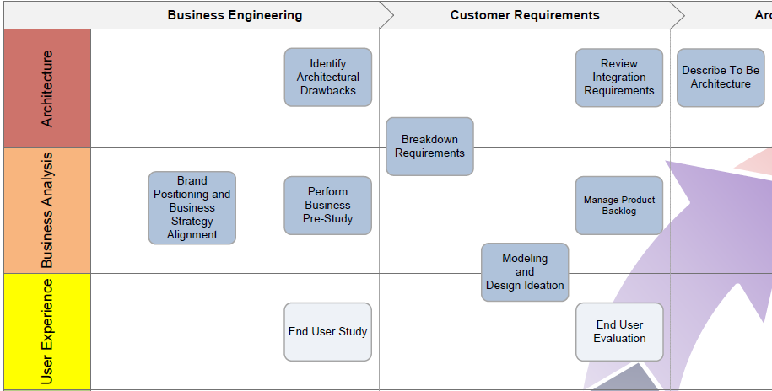
Breakdown Requirements in ADF Context

Slide 3

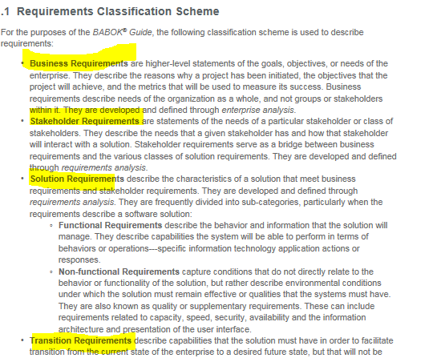
Requirement Breakdown updates
Requirement Breakdown updated together with the Project Handbook and the new EA Guide
New names on upper level requirements
Better adaptation to standards outside Volvo –
BABOK Business Analysis Body Of Knowledge

Slide 4



Requirement breakdown eco system
SO
BR’s
connecting to SO’s
BR
Lowest level BR’s
= Project Directive
StR
WOW - prototyping
Complete
Quality Assured
Bus Req’s (1
TR
SoR
ATR
ATR’s= Arch Technical req’s
Tech Req’s
Quality Assured (1
ASP
ASP’s= Arch Solution
Proposals
Impl Estimates
PBL based on ACC tests
Implementation
Quality
CPM &
Steering Committee
To be
Architecture
UAT
Impl progress
per SPRINT
”Est Overall
Burndown of PBL”
TDD & DDD
User
SW Developer/
Configurator

Slide 5
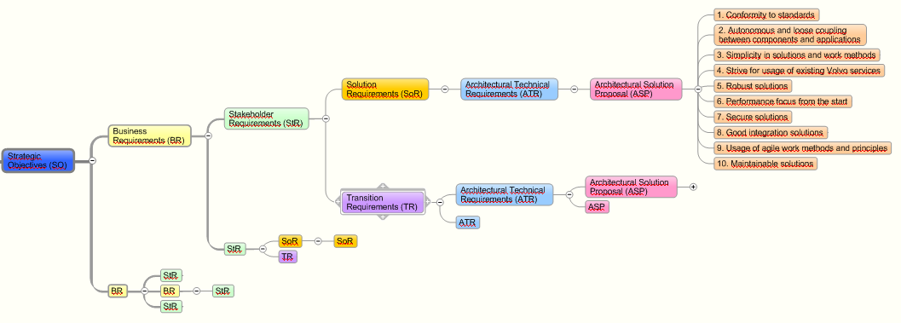
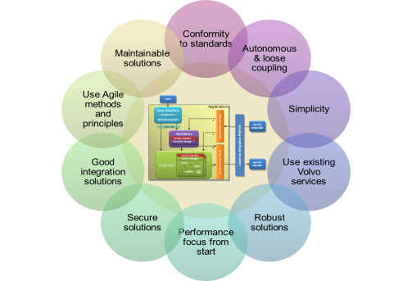
Requirements Breakdown
Top prioritized business requirements are broken down into architectural solution proposals and mapped to the 10 principles.
SO Strategic Objectives Originating from Top Prioritized Business Requirements
SoR Solution Requirements What solution capability is needed to support the StR’s
ATR Architectural Technical Requirements What IT capabilities will support the SoR/TR’s
ASP Architectural Solution Proposal How solutions will in the best way fulfill the ATR’s
BR Business Requirements Statements of goals and objectives to support the SO’s
StR Stakeholder Requirements What stakeholder needs must be met in order to support the BR’s
TR Transition Requirements What transition capability is needed to support the StR’s
ATR Architectural Technical Requirements What IT capabilities will support the SoR/TR’s
Evaluation
Notes:
Build from PRODUCT perspective!
Hierarchical structure: high-level business goals broken down into more detailed requirements and eventually architectural decisions
Puts the IT requirements in a business goals context
Covers functional, non-functional requirements and business rules
The business pre-study is a necessary input to establish the Requirements Breakdown
Reflects business processes, objectives and capabilities
When considering COTS, breakdown is used when comparing and approving the solution(s)
Comparison of alternative architectural approaches by mapping to the 10 AP – clarifying business implications between the alternatives.

Slide 6
Requirements Breakdown - old-new terminology
Previous
New
SO
BSR
BR
StR
ABR
SoR
TR
No Change
ATR
ATR
No Change
ASP
ASP

Slide 7

Why breakdown requirements?
To ensure that:
We have sufficient knowledge of the business drivers behind the change initiative
The technical requirements are based on a real business needs
The requirements considers impacted users, organization & processes
Deliberate architectural decisions regarding solutions are based on strategic targets, business capabilities and technical requirements to fulfill
To create visibility for solution impacts on changes of business requirements
Notes:
Copied from EA Guide

Slide 8

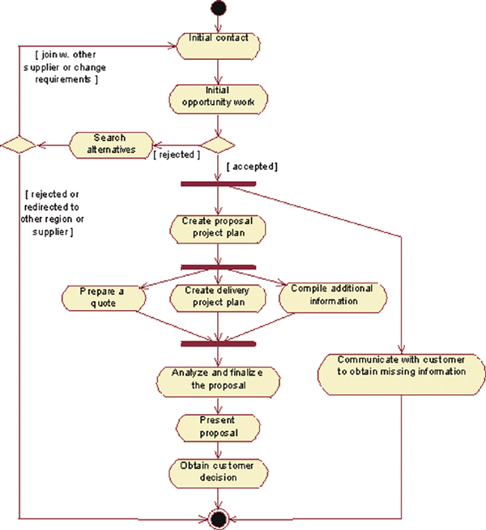
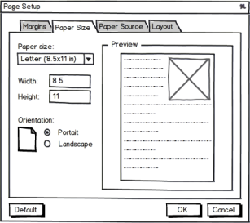


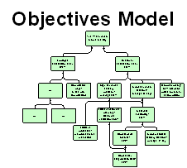

From prestudy to Requirements Breakdown
Volvo Group Strategy
Stakeholder Model
Target Groups, Personas, User Journeys
Modeling and Design Ideation artifacts
High level Business objectives
Other artifacts can also bee input to the SoR/TR
Strategic objectives
SO
BR
StR
SoR/TR
It is the to-be description of the business that should be the input to the Requirements Breakdown
ATR
Process Model
Medium/low level capabilities, derived from to-be processes
High level capabilities,
derived from to-be processes

Slide 9
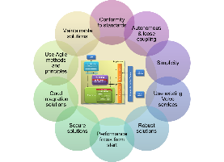

Requirements Breakdown
SoR-1.1
ASP-01
SoR-1
NFR
BR-1
BR-1.1
SoR-2.1
ATR-01
SoR-2
ASP-02
ATR-02
SoR-2.2
COTS
SoR-2.2
Add Spare Part to New Order
SoR-1
Find Parts
Submit Order
Credit Check User
Logon
List of Parts
Add/Remove Spare Part to Existing Order
Updated Draft Order
Extension to be added to the COTS Details to be documented separately
Order Tracking
Delete parts form Order
Canceled Order
Request Spare Part Reservation in Warehouse
Order Confirmed
Confirmed Order
SoR-2.1
Notes:
1 - Tracing Business Requirements to Architectural Solutions
2 - Comparison of alternative architectural approaches by mapping to the 10 AP – clarifying business implications between the alternatives.
3 - Support conscious and explicit architectural decisions derived from Business Needs
4 - Ensure fulfillment of both functional and non-functional requirements in the same context
5 - When considering COTS, breakdown is used when comparing and approving the solution(s)
(the slide animation supports this speaker notes)

Slide 10
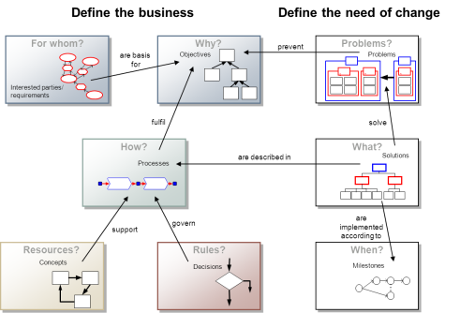
Strategic Objectives & Business Requirements (SO & BR) - Input
Strategy
CAMP (business pre-study)
ATR
ASP
SoR
StR
BR
TR
SO
ATR
ASP
Notes:
Business objectives and needs
Derived from the Volvo AB Business Strategy
Formulated by the business (during business pre-study)
The reason for why the investment/project is executed
The effects the business want to get in the scope of the project/investment
Explaining WHAT business value the intended IT investment shall bring to business

Slide 11
Strategic Objectives (SO)
SoR
ATR
ASP
BR
StR
SO
ATR
ASP
TR
Originating from Top Prioritized Business Requirements
Different Business Areas might have different sets of Requirements

Slide 12
Business Requirements (BR)
SoR
ATR
ASP
BR
StR
SO
ATR
ASP
TR
Statements of goals and objectives to support the SO’s.
Statements of goals, objectives, and outcomes that describe why a change has been initiated.
Describe the metrics that will be used to measure the projects success.
Applies to the whole of an enterprise, a business area, or a specific initiative.
Describe the needs of the organization as a whole and not groups or stakeholders within it.

Slide 13
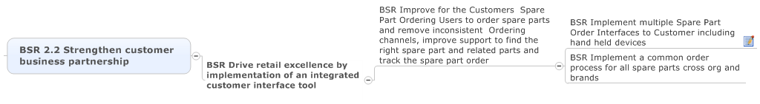
SO & BR compared to the old terminology (BSR)
SoR
ATR
ASP
BR
StR
SO
ATR
ASP
TR
SO
SO
BR
BR
Notes:
BRs will most often be specified in 2 or 3 levels:
1. VG or TD/BA/GF Strategic Target
2. The main objective of this specific proposed IT investment/this organization
3. Business scope on a what level of the proposed IT investment

Slide 14
Stakeholder Requirements (StR)
SoR
ATR
ASP
BR
StR
SO
ATR
ASP
TR
Stakeholder needs that must be met in order to support the BR’s.
Statements of the needs of a particular stakeholder or class of stakeholders.
Describes the needs that a given stakeholder has and how that stakeholder will interact with a solution.
Serve as a bridge between BR and the various classes of SoR/TR.

Slide 15
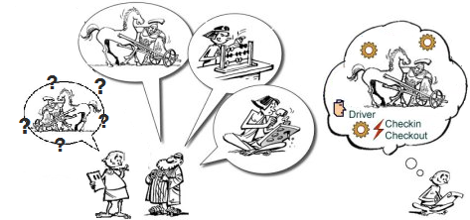
Solution/Transition Requirements (SoR/TR)
SoR
ATR
ASP
BR
StR
SO
ATR
ASP
Business capabilities to achieve a BR
TR
SoR/TRs can affect the architectural solution or not
SoR/TRs can be:
* Activities from business processes
* Business solution features
* Functional requirements
* End user study documentation
* Non-functional requirements
* Business Rules
* Security requirements
* …
Notes:
Business capabilities needed to achieve a BR
Everything (from the business perspective) what is needed to achieve BR
ABRs that not affect the architectural solution will not need to be further detailed
Most SoR/TRs will drive IT-solution needs and technical requirements (ATRs)
ABRs can be:
* Activities from business processes
* Business solution features
* Functional requirements
* End user study documentation
* Non-functional requirements
* Business Rules
* Security requirements
…

Slide 16
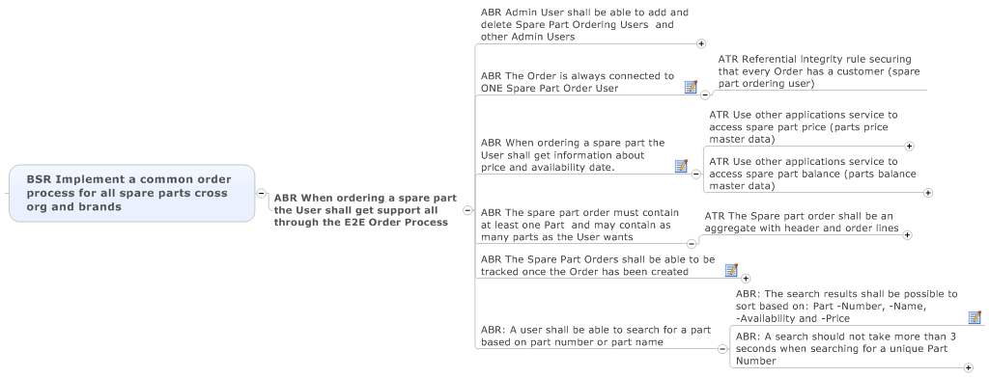
StR & SoR compared to the old terminology (ABR)
SoR
ATR
ASP
BR
StR
SO
ATR
ASP
TR
BR
StR
SoR
Notes:
Capability is the ability to perform actions.
Requirement is a singular documented functional need that a particular solution must be able to perform.

Slide 17
Solution Requirements (SoR)
SoR
ATR
ASP
BR
StR
SO
ATR
ASP
TR
Solution capability that is needed to support the StR’s.
Describes the capabilities and qualities of a solution that meets the stakeholder requirements.
Provides the appropriate level of detail to allow for the development and implementation of the solution.
Can be divided into two sub-categories, Functional requirements (system capabilities/functionality) and Non-functional requirements (system characteristics/environmental conditions).
Will only need further detailing into ATR’s if they affect the architectural solution. Most SoR’s will drive IT-solution needs and technical requirements (ATR’s).
Notes:
Capability = the ability to perform actions.

Slide 18
Transition Requirements (TR)
SoR
ATR
ASP
BR
StR
SO
ATR
ASP
TR
Transition capability that is needed to support the StR’s.
Describes the capabilities that the solution must have and the conditions the solution must meet to facilitate transition from the current state to the future state.
Differentiated from other requirement types because they are always temporary in nature and not needed once the change is complete.
Cannot be developed until both an existing and new solution are defined.
Address topics such as data conversion, training and business continuity.
Will only need further detailing into ATR’s if they affect the architectural solution. Most TR’s will drive IT-solution needs and technical requirements (ATR’s).

Slide 19
Architectural Technical Requirements (ATR)
SoR
ATR
ASP
BR
StR
SO
ATR
ASP
TR
What capabilities are needed from the IT solution to support the SoR’s and TR’s
what are the technical requirements on the IT-Solution
Specified by the Lead architect and the IT-solution team, input from the SoR/TR’s and Analysis Artifacts (MADI)

Slide 20


Architectural review to find ATR’s
StR/SoR/TR
StR/SoR/TR
Analysis Artifact (MADI)
Architecturally significant
End User Study Documentation
SoR
ATR
ASP
BR
StR
SO
ATR
ASP
TR
20
Notes:
Specify the technical requirements on the IT-Solution
Architecturally significant
Challenges the architecture and may impact the technical architecture/drive the architecture of the solution
IT owns
Specified by the Lead architect and the IT-solution team (together!)
Challenge the StR/StO/TR’s, making sure they have the right level of details AND that all non-functional requirements have been found.
Input from the Analysis artifacts, and the End User Study also
The Architectural Technical Requirements will be possible to solve in several different ways
-> It is important that the business prioritizes the non-functional requirements e.g. Performance vs. Robustness vs. Speed of Change etc.
Broken down into
More detailed ATR’s if needed
Architectural Solution Proposals (ASP)

Slide 21
Architectural Technical Requirement (ATR)
Example
SO – Strengthen customer
business partnership.
BR – Drive retail excellence by
Implementation of an integrated
Customer interface tool
BR – One common order process
for all spare parts cross org and
brand
StR – Possible to order spare parts
through the E2E Order process
ASP – Store documents in database as BLOBS
Efficiency
SoR – Possibility to upload and attach any type of document to the spare part order
ATR – System has to support storing of files
ASP – Store documents in database as CLOBS
Recoverability
ASP – Store documents on the app server file system
Performance
Reliability
SoR – Possibility to store documents of format Word, Excel, ppt, and PDF
ASP – Write in-house solution to store documents in file system outside of db and app server
Quality
SoR – The solution must be able to handle storage of documents for at least 10 years
Security
ASP – Integrate to Teamplace and store the files there
Capacity
SoR – Possibility to upload files with size up to 200 MB
ASP – VIAP appointed Document Management solution (Orion)
Portability
Maintainability
SoR – Documents should be archived after being stored for 5 years
ASP – 3rd party Document Management COTS product
Modifiability
SoR – Solution must be easily extendable making sure future changes minimize impact to existing system functions
Backup
Scalability
SoR – Solution must be scalable and able to handle a growth of 30 000 documents per year
Extensibility
Notes:
Some of the new requirements (e.g. Documents should be archived after being stored for 5 years) will have their own ATR and ASP(s) – but this animation was difficult enough anyway ☺
Extensibility (the implementation takes future growth into consideration. It is a systemic measure of the ability to extend a system and the level of effort required to implement the extension)
Scalability (the ability of a system, network, or process to handle a growing amount of work in a capable manner or its ability to be enlarged to accommodate that growth)
Backup (copying and archiving of computer data so it may be used to restore the original data)
Modifiability (cost of change)
Maintainability (the ease with which a product can be maintained to e.g. meet new requirements)
Portability (the usability of the same software in different environments)
Capacity (current and forecast)
Security (the degree of resistance to, or protection from, harm)
Quality (the non-inferiority or superiority of something; it is also defined as fitness for purpose)
Reliability (mean time between failures)
Performance (the amount of useful work accomplished by a computer system compared to the time and resources used)
Recoverability (mean time to recover)
Efficiency (resource consumption for given load)

Slide 22
Architectural Solution Proposal (ASP)
Analysis Artifact (MADI)
ATR
End User Study Documentation
ATR
ASP
StR
SoR
BR
SO
ATR
ASP
TR
Notes:
A set of ASPs combined can in some cases support a specific quality i.e. Short time to market, robustness and reliability or high performance. It is important to discuss these qualities with the business to find the right set of ASPs to solve a specific ATR.
There can be several ”competing” suggested solutions (ASP’s) to one ATR (1-many relation). When adding the 10 principles to the ASP it is a help in deciding which solution is the best alternative.
-> Keep also the discarded alternatives, and add a text describing why this solution was not chosen.
Each ASP should be evaluated against the 10 Architectural Principles
Specified by the Lead architect and the IT-solution team

Slide 23

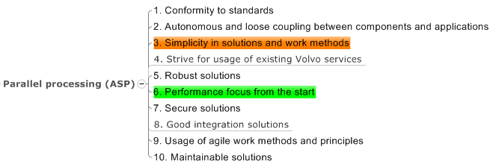
Architectural Solution Proposals (ASP)
SoR
ATR
ASP
BR
StR
SO
ATR
ASP
TR
What solution is required to fulfill the ATR in the context of the StR/SoR/TR and SO/BR
ASP is in ‚1 to many’ relation to One ATR: several different possible solution for one technical requirement
Specified and owned by the lead architect and the IT-solution team, input from the ATR in the context of the SoR/TR and the Analysis Artifacts (MADI)
For each ASP, an evaluation shall be done towards the 10 architectural principles
Notes:
The reason for the evaluation is to be aware of the implication an ASP will have for each of the 10 principles. This awareness should then drive deliberate decisions regarding which ASPs to utilize to best support the ATR and SoR/TR it is derived from.

Slide 24
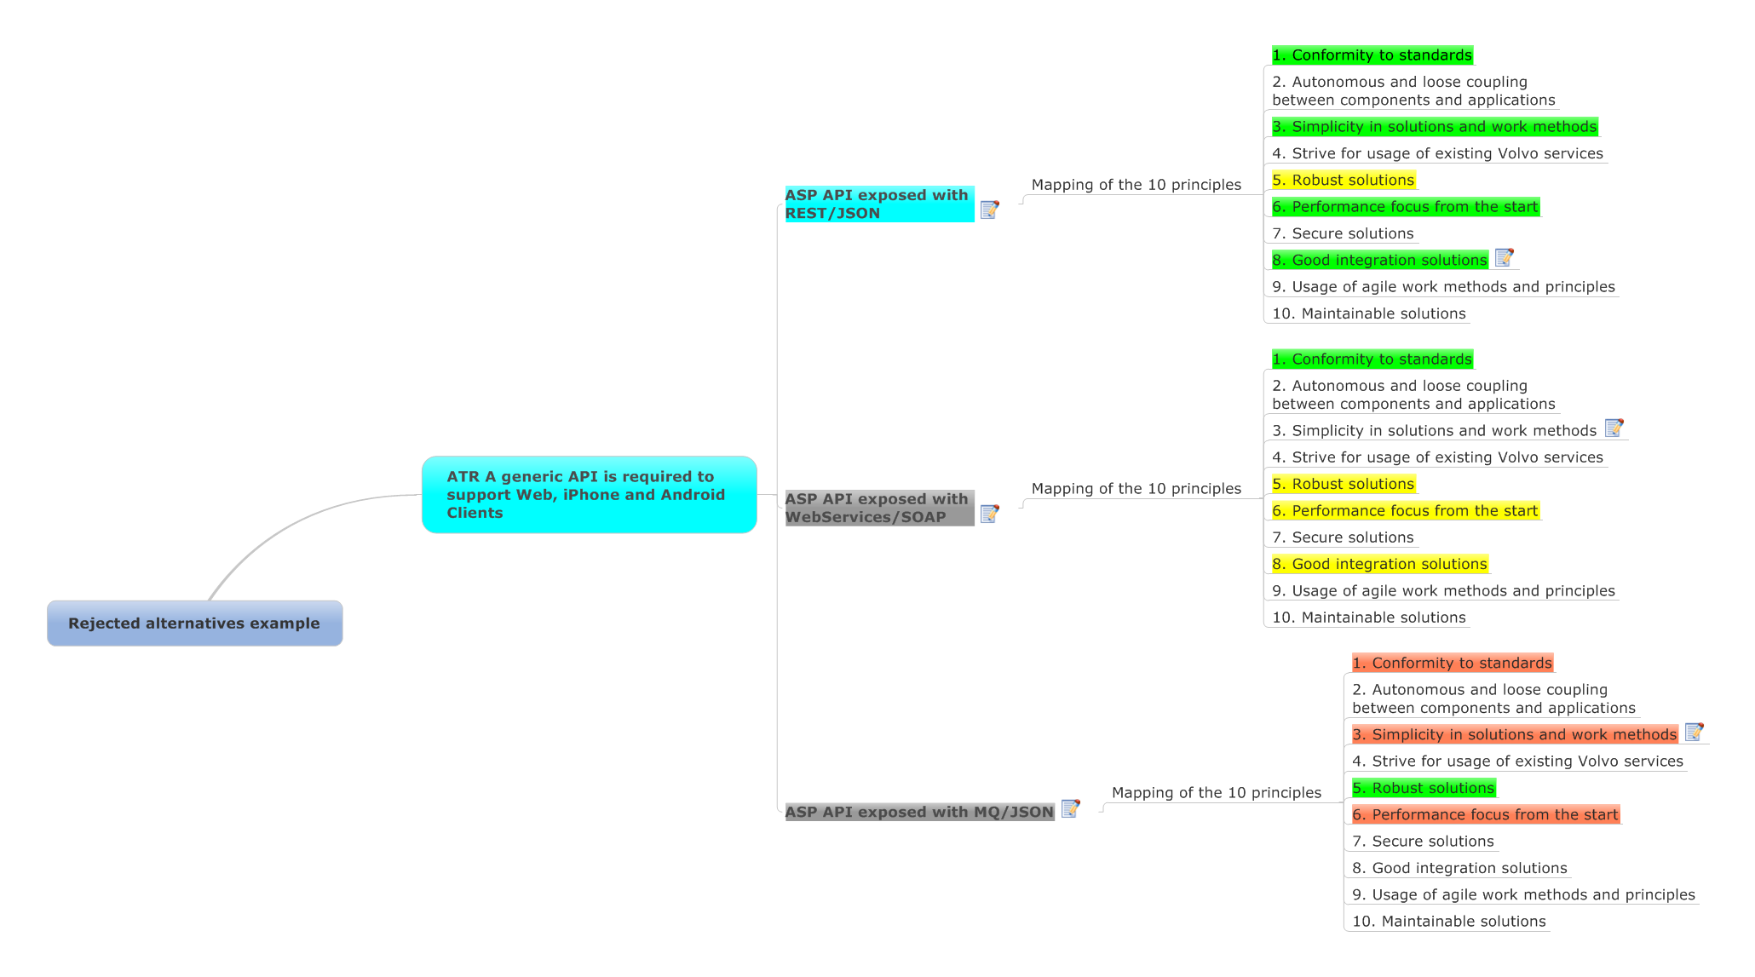
Keep also rejected solutions (ASP)
All architectural decisions should be documented,
also the rejected alternatives
Add notes describing why an alternative
was chosen/rejected
Notes:
ASP is the solutions to ATR’s. BUT sometimes you end up with having several ”competing” suggested solutions (ASP’s) to one ATR (1-many relation). When adding the 10 principles to the ASP it is a help in deciding which solution is the best alternative.
It is good to show the also the disregarded/rejected alternatives in the Requirement Breakdown.
This kind of fact log should be a help to remember why a certain decision was made. Lot of design decision will be challenged at a later stage (in project or maintenance) then it is important to be able to understand why a certain solution was chosen.

Slide 25
For more example see DRS Tutorial on Requirements management
“Requirements management Intro”

Slide 26
Cheat Sheet
Previous
SO Strategic Objectives Originating from Top Prioritized Business Requirements
BSR
BR Business Requirements Statements of goals and objectives to support the SO’s
StR Stakeholder Requirements What stakeholder needs must be met in order to support the BR’s
ABR
SoR Solution Requirements What solution capability is needed to support the StR’s
TR Transition Requirements What transition capability is needed to support the StR’s
No Change
ATR
ATR Architectural Technical Requirements What IT capabilities will support the SoR/TR’s
No Change
ASP
ASP Architectural Solution Proposal How solutions will in the best way fulfill the ATR’s

